Slide 1
Report
for Aug 2020 MP
BFX - AT100
Date : 03 Sep 2020
Prepared by: Heng Ruan

Slide 2
Issue Description
September 2020, ALT customer complain [BFX-AT100] Agust 2020 Mass production issue.
Defect Total:
1. HDMI output noise (Critical ) : 2/500pcs (0.4%)
2. Can not google login with RCU (Critical) 1/500pcs (0.2%)
3. SET label print is not completely (Major) : 1/500pcs (0.2%)
4. Ethernet cable packing NG (Major) : Not counted (20%)

Slide 3
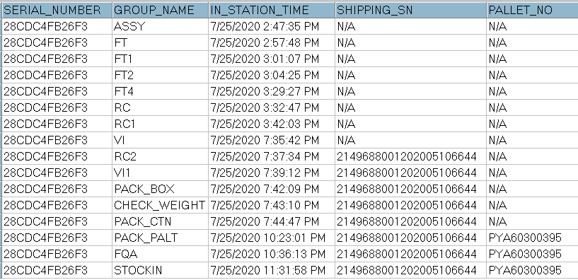
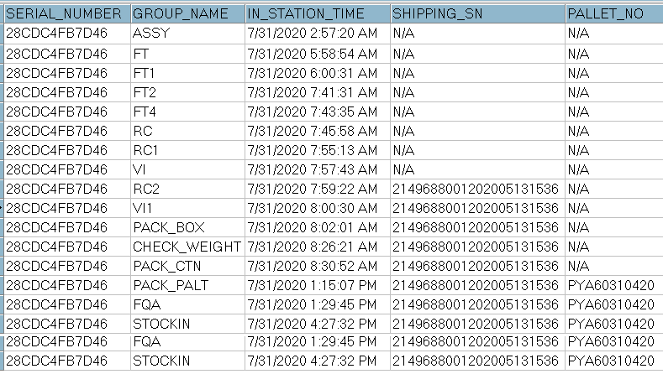
1. HDMI output noise
Issue Description | Root Cause | Actions | Owner | Due Date | Status
Phenomenon: HDMI output noise. Type: Critical Q’ty : 2/500pcs DR: 0.4% | Checked history. This unit was passed all stations smoothly. Waiting Visual inspection and X-Ray inspection when NG sample turn back Foxconn VN. 3. Checked console information --> no issue found. | 1. Waiting NG sample for analysis detect issue. | PE-Loc TE-Allan | TBD TBD

Slide 4
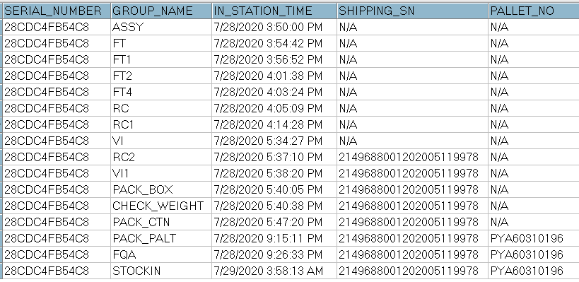
2. Can not google login with RCU
Issue Description | Root Cause | Actions | Owner | Due Date | Status
Can not google login with RCU Type: Critical Q’ty : 1/500pcs DR: 0.2% | Check production data no found abnormal issue. 2. This unit no test OBA function, so no test accessory RCU function on Fii side. Root Cause : Waiting analysis NG sample find out root cause. | Waiting NG sample for analysis detect issue | PQE-Hang PE: Loc | TBD TBD

Slide 5
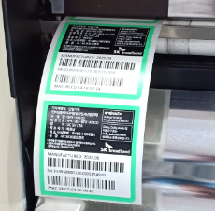
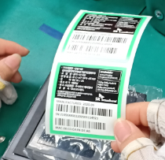
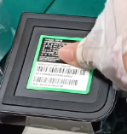



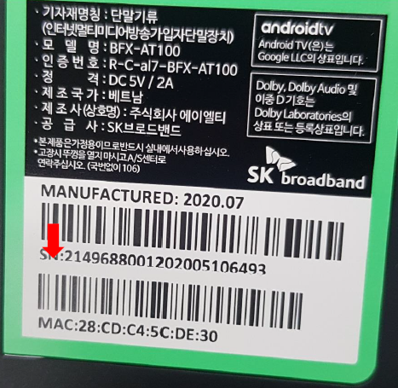
3. SET label print is not completely
Issue Description | Root Cause | Actions | Owner | Due Date | Status
Phenomenon: SET label print is not completely Type: Major Q’ty : 1/500pcs DR: 0.2% | Root cause: - This is the technical errors. Make print out content text not full, as customer info. Escaped cause : - OP printer label and Op visual inspection don’t careful check print content. | 1. Add NG picture to SOP printer label and visual inspection station. 2. Training OP online by quality Alert issue. 3. Line leader often check and monitor all operators at all stations to make sure their operating comply with SOP. | IE: Huyen PD: Dung IT:Phuc | 01-Sep
Print label
Check after print
Paste label on housing

Slide 6
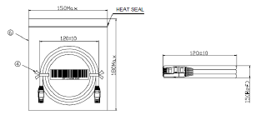
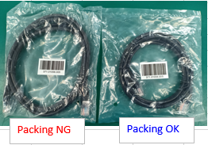

4. Ethernet cable packing NG
Issue Description | Root Cause | Actions | Owner | Due Date | Status
Phenomenon: Ethernet cable packing NG Type: Major Q’ty : 1/500pcs DR: 0.2% | Vendor root cause: The Ethernet have 2 kind packing method, Normal the cable have to tie maximum is 120 (+-10 ) mm, but the NG Ethernet cable is 150mm. This is cause incoming material have 2 kind mix together in carton box. Escaped cause (at FXN): IQC inspection incoming material follow AQL 0.4 , So no defect this issue. All accessory no test function online, just test OBA follow AQL 0.65. - Online production this is accessory material , packing inside PE bag, no any notice from QA, no reject this issue. | FXN SQE was responsible for inform to vendor this issue, remark this issue on vendor side, Waiting sorting result from vendor. FXN action: - Remark from IQC new coming material inspection this issue, - Showed NG sample and re-trained operator at put accessory station for checking requirement. - Line leader often check and monitor all operators at all stations to make sure their operating follow SOP. | SQE-Khoa IQC: Long PD:Dung | 22-Aug

